Slide 1



UNIT 3
LESSON 9
Take action
Part 4

Slide 2
protection starve production pollute threat harm destructive endanger toxin
NOUN | VERB | ADJECTIVE
protection
threat
starve
threat
destructive
production
pollute
harm
harm
toxin
endanger
Think of other forms of all the words in the table e.g. protection/protect/protective.

Slide 3
NOUN | VERB | ADJECTIVE
protection threat production harm toxin starvation pollution endangerment destruction | protect threat produce harm toxicate starve pollute endanger destroy | protective threatening produced harmful toxic starved polluted endangered destructive
What are all those words related to?
'We abuse land because we see it as a commodity belonging to us. When we see land as a community to which we belong, we may begin to use it with love and respect.’
- Aldo Leopold, an influential American scientist and conservationist
ecology
environment

Slide 4
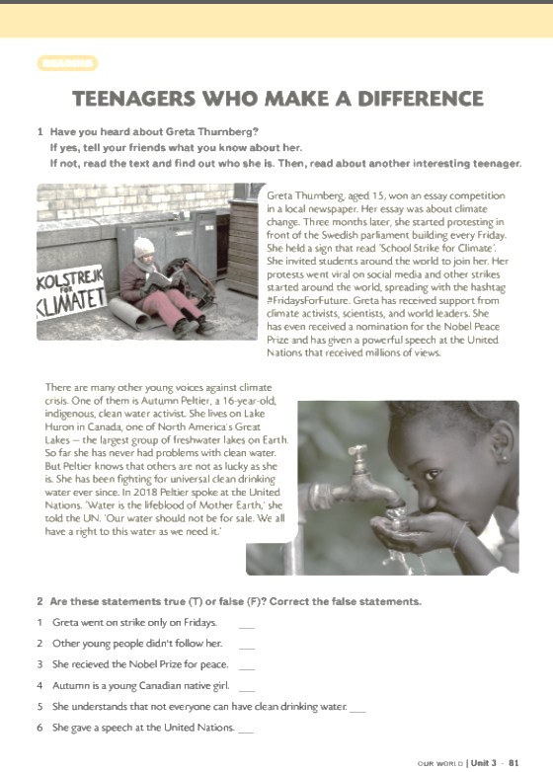
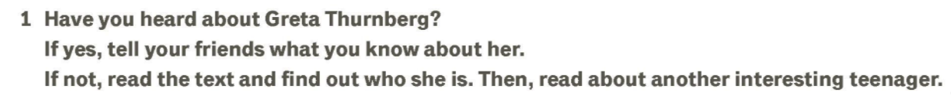
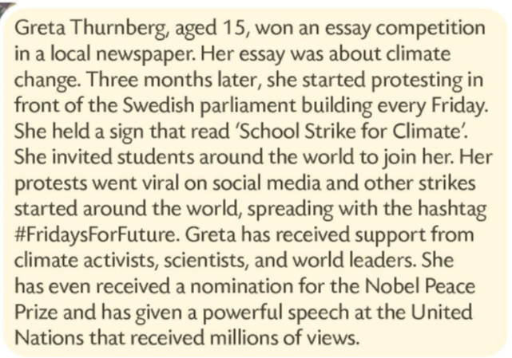
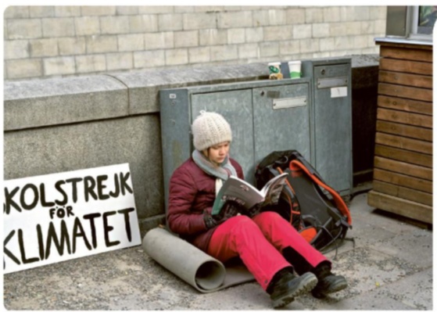

Slide 5
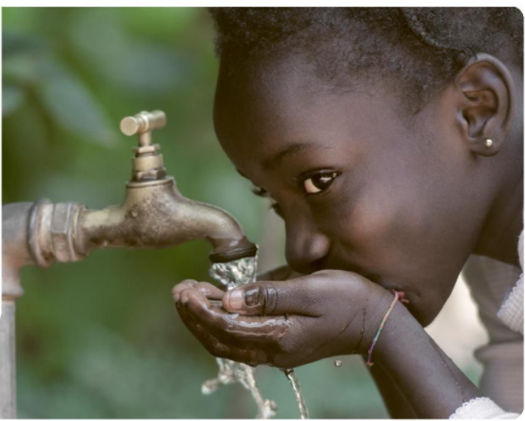
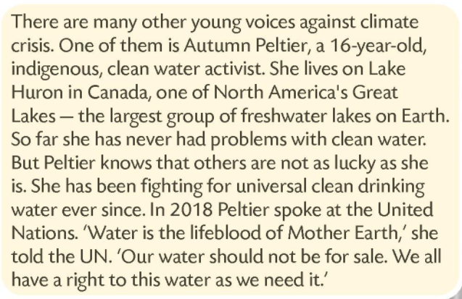
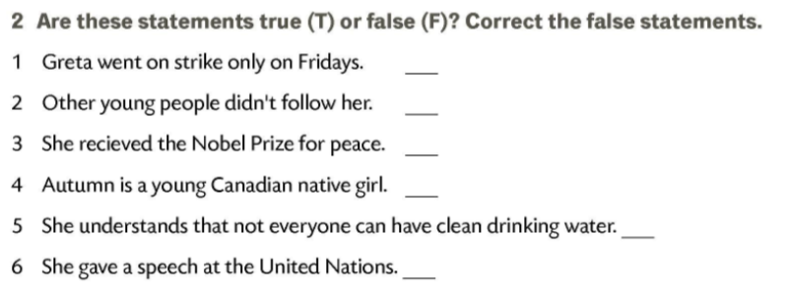
T
F
Greta has received support from climate activists scientists, and world leaders.
F
She has received a nomination for the Nobel Peace Prize.
T
F
She says that everyone has the right to have clean drinking water.
T

Slide 6
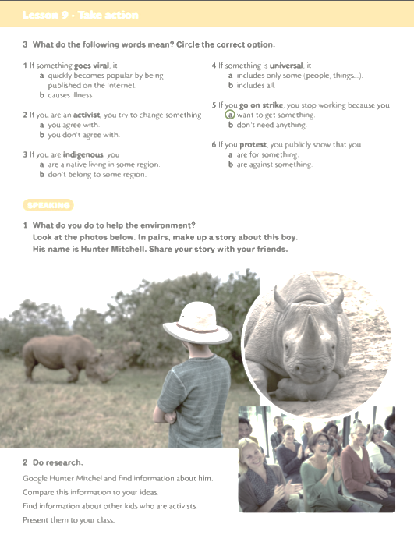
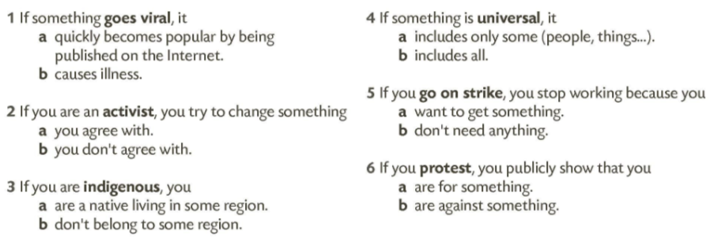
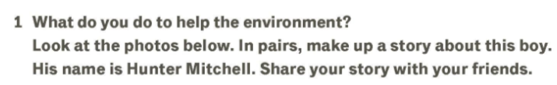
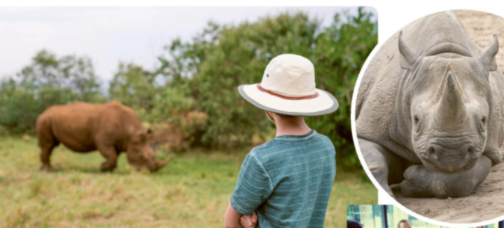

Slide 7
